Slide 1

CMR COLLEGE OF ENGINEERING & TECHNOLOGY
Kandlakoya, Medchal, Hyderabad - 501401
Department of Computer Science and Engineering
MEDICAL INSURANCE PREMIUM PREDICTION
PRESENTED BY:
BHAGYA LAXMI - 20H51A05F7
YASMEEN - 20H51A05G1
B.SREE HARSHA -20H51A05M9
Under esteemed guidance of :
Mr.B.SIVAIAH

Slide 2
Outline
Abstract
Introduction
Literature survey
Existing system
- Problems in existing system
Research Objective of Presentation
Problem Definition
Research work
- Proposed system architecture
- Methods
- Comparison of Proposed system with an existing system
Performance Measure
Results
Conclusion
Future Work
References

Slide 3
Abstract

Slide 4
ABSTRACT
We live on a planet full of threats and uncertainty. Including People, households, properties are exposed to different risks. These risks range from risk of health diseases to death if not get protection, and loss in property.
Therefore Insurance is one of the policies that either decreases or removes loss costs incurred by various risks.
It becomes important for insurance companies to be sufficiently precise to measure the amount covered by this specific policy and the insurance charges.

Slide 5
INTRODUCTION

Slide 6
Introduction
Medical insurance cost prediction using Random Forest Regressor, this uses linear regression,SVR,Ridge Regressor algorithms to predict the insurance. But it gives the 76% accuracy.
Our Project is Predicting medical insurance premium is a regression problem where we try to estimate the cost of an insurance premium based on certain features like age, BMI, number of dependents, smoking habits, etc.
Along with existing algorithms we are using xgboost-extreme-gradient-boosting algorithm for more accuracy.

Slide 7
Literature Survey

Slide 8
Problems in existing system
The existing system gives less Accuracy
The individuals who had already worked in this project used various types of algorithms like Linear Regression , Support Vector Machine , Decision Tree , Random Forest and Gradient Boosting.
This all algorithms gave less accuracy (70-78%)

Slide 9
Research Objective

Slide 10
Research objective
To develop a predictive model that accurately estimates medical insurance costs for individuals based on relevant demographic, health-related, and lifestyle factors.
The goal is to provide insurance companies and policyholders with a reliable tool for pricing and planning.
This objective outlines the main aim of our research, which is to create a predictive model for medical insurance costs, and highlights the potential benefits of such a model for both insurance providers and individuals seeking coverage

Slide 11
Problem Definition

Slide 12
Problem Definition
Our solution for medical insurance premium prediction involves the utilization of various technologies and tools.
Along with the existing algorithms i.e-Linear Regression , SVR , Ridge Regressor , we are usingxgboost-extreme-gradient-boosting algorithm for more accuracy.
And the main use of the project is to get the information about the insurance that should be paid by the person on the basis of their BMI and also on their smoking so that it gives the perfect idea that should be paid annually by the person.

Slide 13
Research work

Slide 14
Proposed System Architecture
Start
Collect
Dataset
Import Data to Jupyter
Analyse
Data
Processing on Data
Apply Regression Techniques
XG Boost
Gradient Boosting
Random Forest
Linear Regression
Training Model
Testing Model
Predict Insurance Cost
End

Slide 15
Proposed Methods
Training: After the necessary data has been formatted and prepared, the model can begin its training and testing phases. A key focus during the training phase is choosing the appropriate model for the task at hand. This may involve deciding on the optimal modelling strategy or determining the best parameter values for a particular model (V. Roth, 2014) In some cases, this process is referred to as model selection because various models may be tested and the one that performs the best, is ultimately chosen , which is created using extreme vectors and points called support vectors.
Prediction: The model used for predicting the insurance sum for health was based on the relationship between certain features and the label. The accuracy of this prediction was determined by the extent to which the expected value matched the actual amount. In order to improve the accuracy, the model employed various characteristics and methods. It was found that the amount of data used for training had a significant impact on the accuracy, with a larger train size leading to better results.

Slide 16
Proposed Method Description
The dataset is split into 2 sections.
One half for model training and other part for model analysis or testing.
Training data makes up for eighty percent of the whole data used, and the rest for test data. all of those models are trained with the training data part and so evaluated with the test data.
The accuracy is checked with the assistance of r2 score.

Slide 17
Proposed Method Description
Name | Description
Age | Age of client
BMI | Body mass index
No. of kids | Number of children the client have
gender | Male / Female
Smoker | Whether a client is a smoker or not
Alcoholic | Whether a client is drinks alcohol or not
Diabetic | Whether client is having diabetes or not
region | Whether the client lives in southwest, northwest, southeast or northeast
Charges (Target Variable) | Medical Cost the client pay
Dataset Overview

Slide 18
Comparison of Proposed system with an Existing System
In our proposed system , we had used an additional algorithm that is XG-Boost Extreme Gradient Boosting Algorithm through which the accuracy has increased to 90 - 95%.
Where as in existing system they used various types of algorithms like Linear Regression , Support Vector Machine , Decision Tree , Random Forest and Gradient Boosting. This all algorithms gave less accuracy (70-78%) when compared to our project.

Slide 19
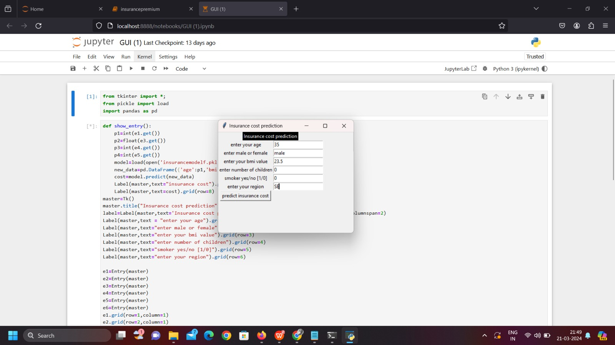
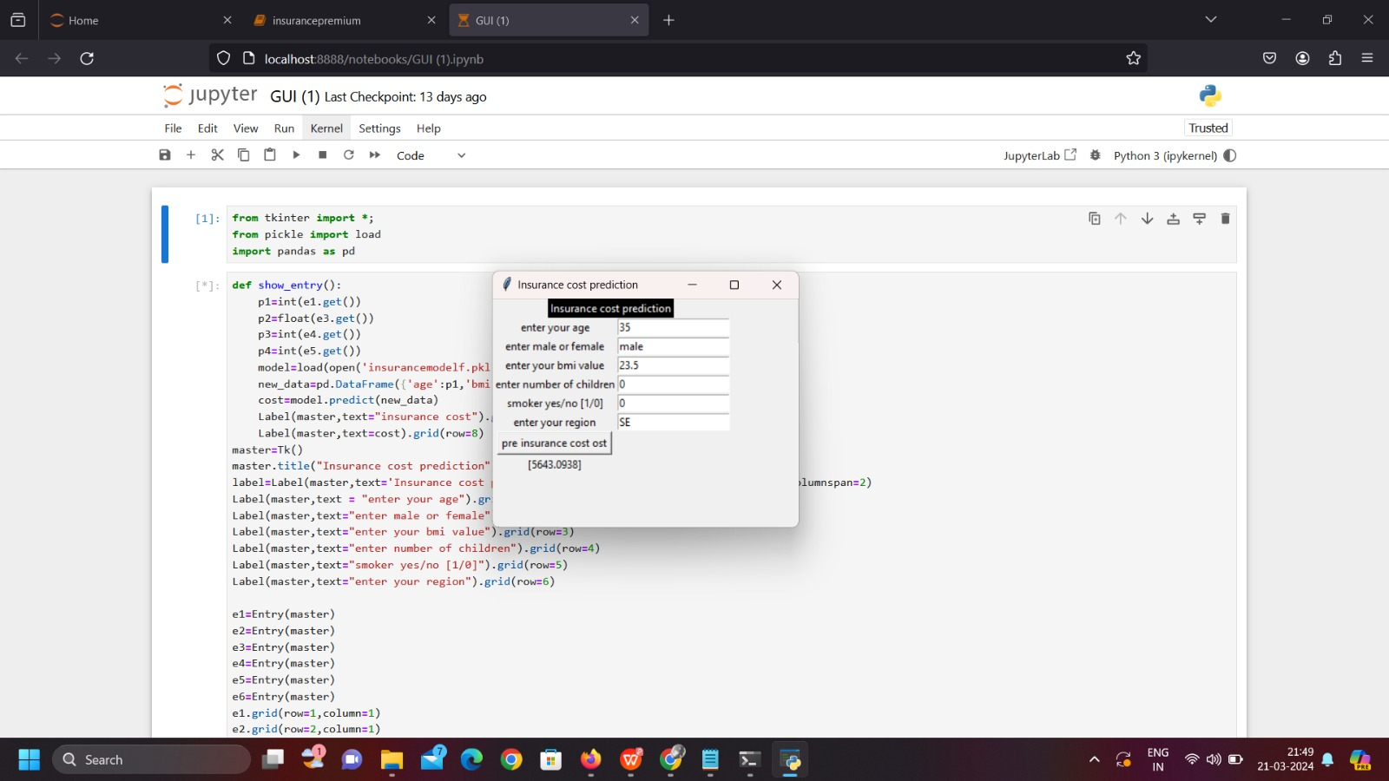
Performance Measure
Output - 1
Output - 2

Slide 20
Result
The following results can be seen in Prediction:
1)Linear Regression Algorithm:
The accuracy of the Linear Regression Algorithm is
78.334%.(Bertsimas, M.V. otter, 2018)
2)Support Vector Machine:
The accuracy of the Support Vector Machine Algorithm is 7.229%
3)Random Forest Regression:
The accuracy of Random Forest Regression is 87.006% (Stucki ,
Finland , 2019).
It was found that the amount of data used for
training had a significant impact on the accuracy, with a larger train
size leading to better results (Kenward , J.A. , 2019)
Gradient Boosting Algorithm :
The Accuracy of the Gradient Boosting Algorithm is 87.776%.

Slide 21
Conclusion
Our project has practical implications for healthcare providers, insurers, and individuals seeking insurance coverage.
It can guide fairer pricing strategies and informed decision-making in the healthcare finance sector.
Continued data collection and model refinement could enhance prediction accuracy.
Exploring the impact of policy changes and new data sources can further enrich our insights.

Slide 22
Future Work
The use of the Random Forest algorithm allows for the introduction of unpredictability in the feature selection process, which can improve prediction accuracy
In order to assess the scalability of the system, it would be beneficial to test it on a dataset with at least a million records in the future.
Distributed frameworks like Spark and Hadoop can be utilized to handle large amounts of data and enhance the scalability of the system.
Currently, the algorithm is being trained and tested using thousands of records

Slide 23
References
Gupta, S., & Tripathi, P. (2016, February). A leading trend of data analytics with health insurance in India. In 2016 International Conference on Innovation and Challenges in CS (ICICCS-INBUSH) (pp. 64-69). IEEE.
[Yerpude, P., Gudur, V.: Prediction modeling of crime dataset using data mining. Int. J. Data Min. Knowl. Manage. Process (IJDKP) 7(4) (2017)
Grosan, C., Abraham, A.: Intelligent Systems: A Modern Approach, Intelligent Systems Reference Library Series. Springer, Cham (2011)
https://www.ijraset.com/research-paper/medical-insurance-cost-prediction-using-machine-learning

Slide 24
Thank You!

